Slide 1
Music Recommendation Million Song Dataset
MSCA 31013 1 Big Data Platforms
Sasha Roberts
Skye Zhang
Sowmya Nallapaneni
Vineela Potula

Slide 2
Agenda
Business Problem
Our Dataset + Preparation
Analysis & Visualization
Machine Learning Models
Next Steps

Slide 3
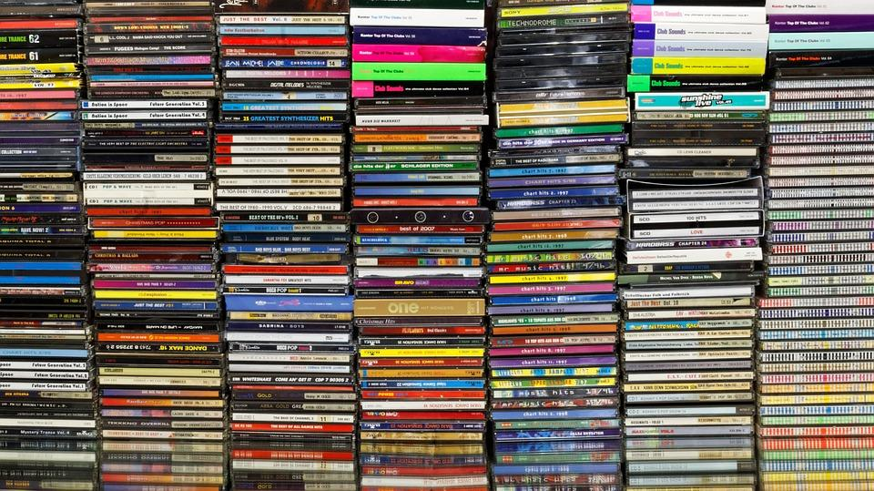
Business Problem
We are trying to build a recommendation engine for a music streaming app using:
>> Hotness: Recorded when downloaded (in December 2010)
>> MFCC: A mathematical representation of sound

Slide 4
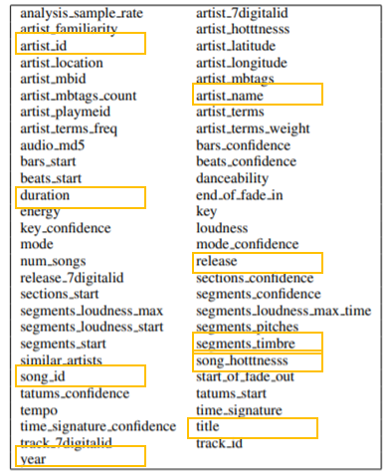
Million Song Dataset
Dataset Size: 280 GB 44, 745 unique artists 515, 576 dated tracks
Years: 1926-2010 (we focused on 2000 to 2010)
Our Subset: 6.5+ GB 76,799 songs
Data Access: Amazon Public Dataset Snapshot
Data Format: Stored using HDF5 format.
Contains: Each file represents a Song that contains audio features and metadata
Notes:
The data is stored using HDF5 format to efficiently handle the heterogeneous types of information such as audio features in variable array lengths, names as strings, longitude/latitude, similar artists, etc.
Hierarchical Data Format (HDF) is a set of file formats (HDF4, HDF5) designed to store and organize large amounts of da

Slide 5



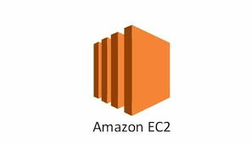

Data Moved to GCP
Bucket
>> Preprocessing
>> Visualizations
>> Spark ML
Clone AWS EC2
Instance
GCP Dataproc
Data Subset
--Testing--
RCC
Docker
Local
Code
Move to GCP

Slide 6
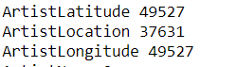
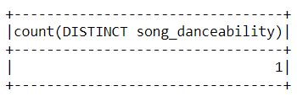
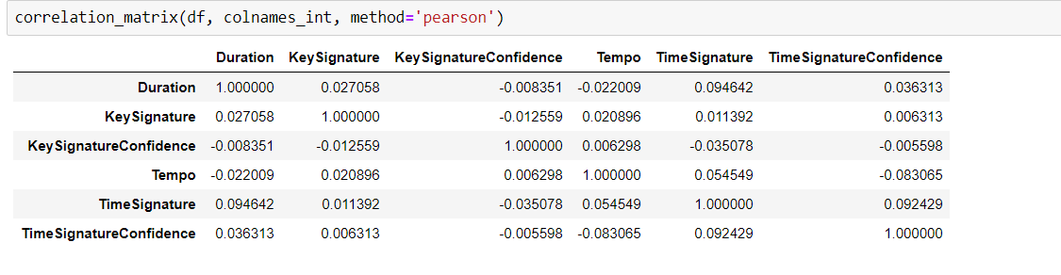
Data Preprocessing
Missing Values
Invalid Values
Notes:
Dancebality - 0
65% of lat, long are null
50% locations are null
No Highly correlated variables

Slide 7
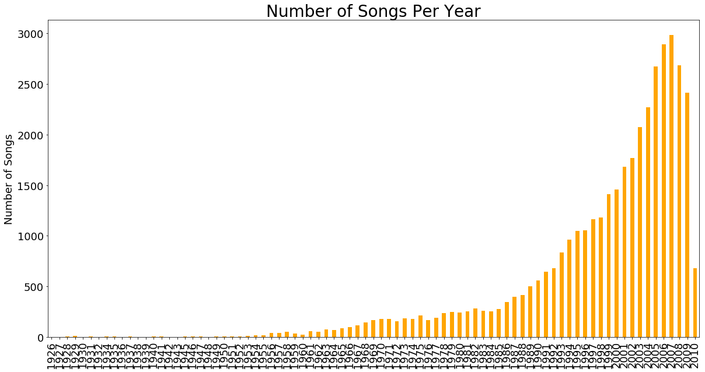
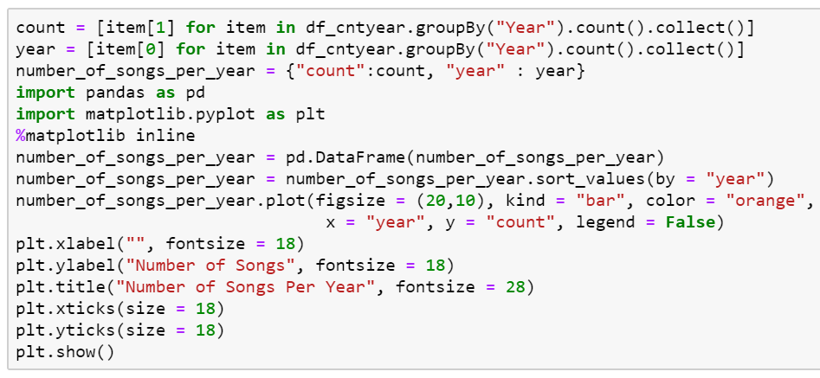
# of songs begin to increase around 1985. This could be due to the introduction of CDs in 1982

Slide 8
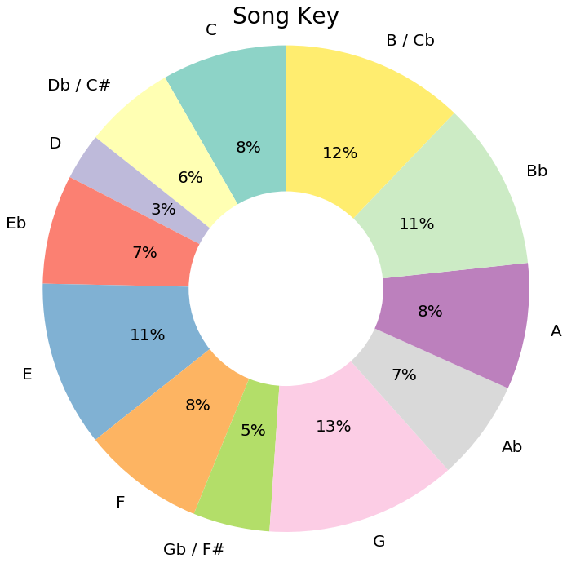
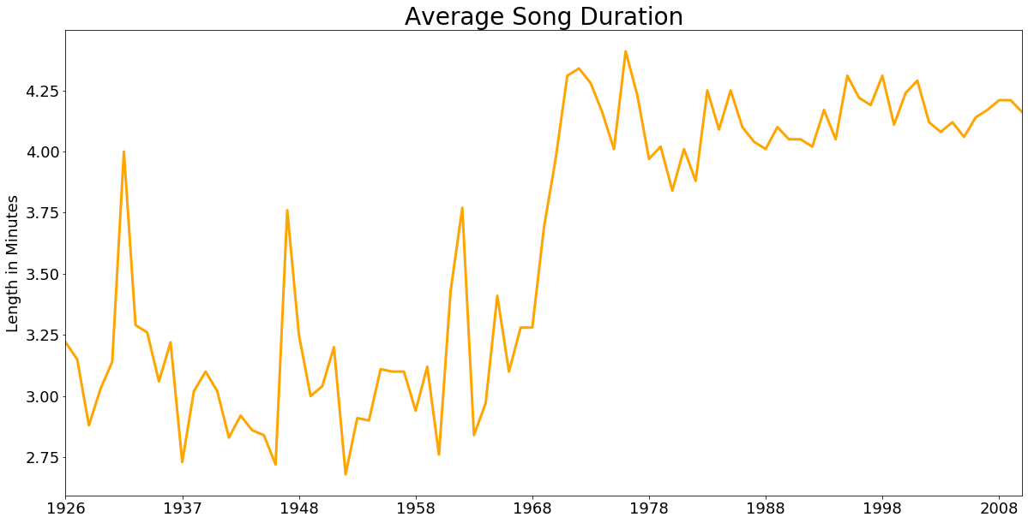
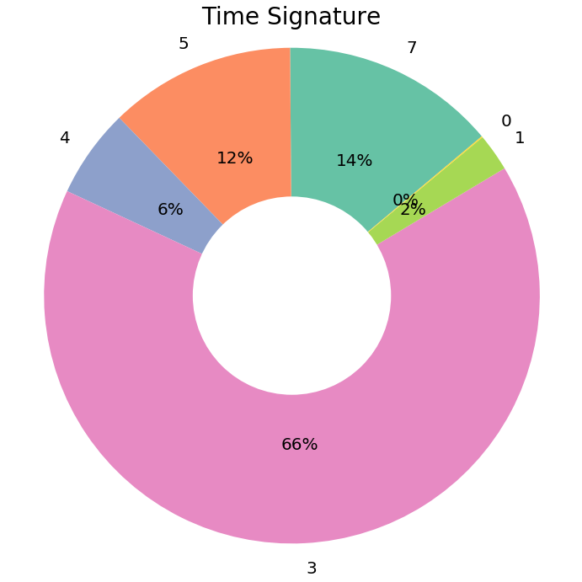
The most popular Song Key isn’t clear but G, B/Cb, and E are popular in this dataset.
Song Duration rapidly increased near 1970 and has stayed above 3.75 minutes ever since
The most popular Time Signature was ‘3’ but documentation was unclear what this maps to. The most common meter in music is 4/4.
Most Hot Songs Have A Tempo of 122 Beats Per Minute
Anatomy of a Song

Slide 9
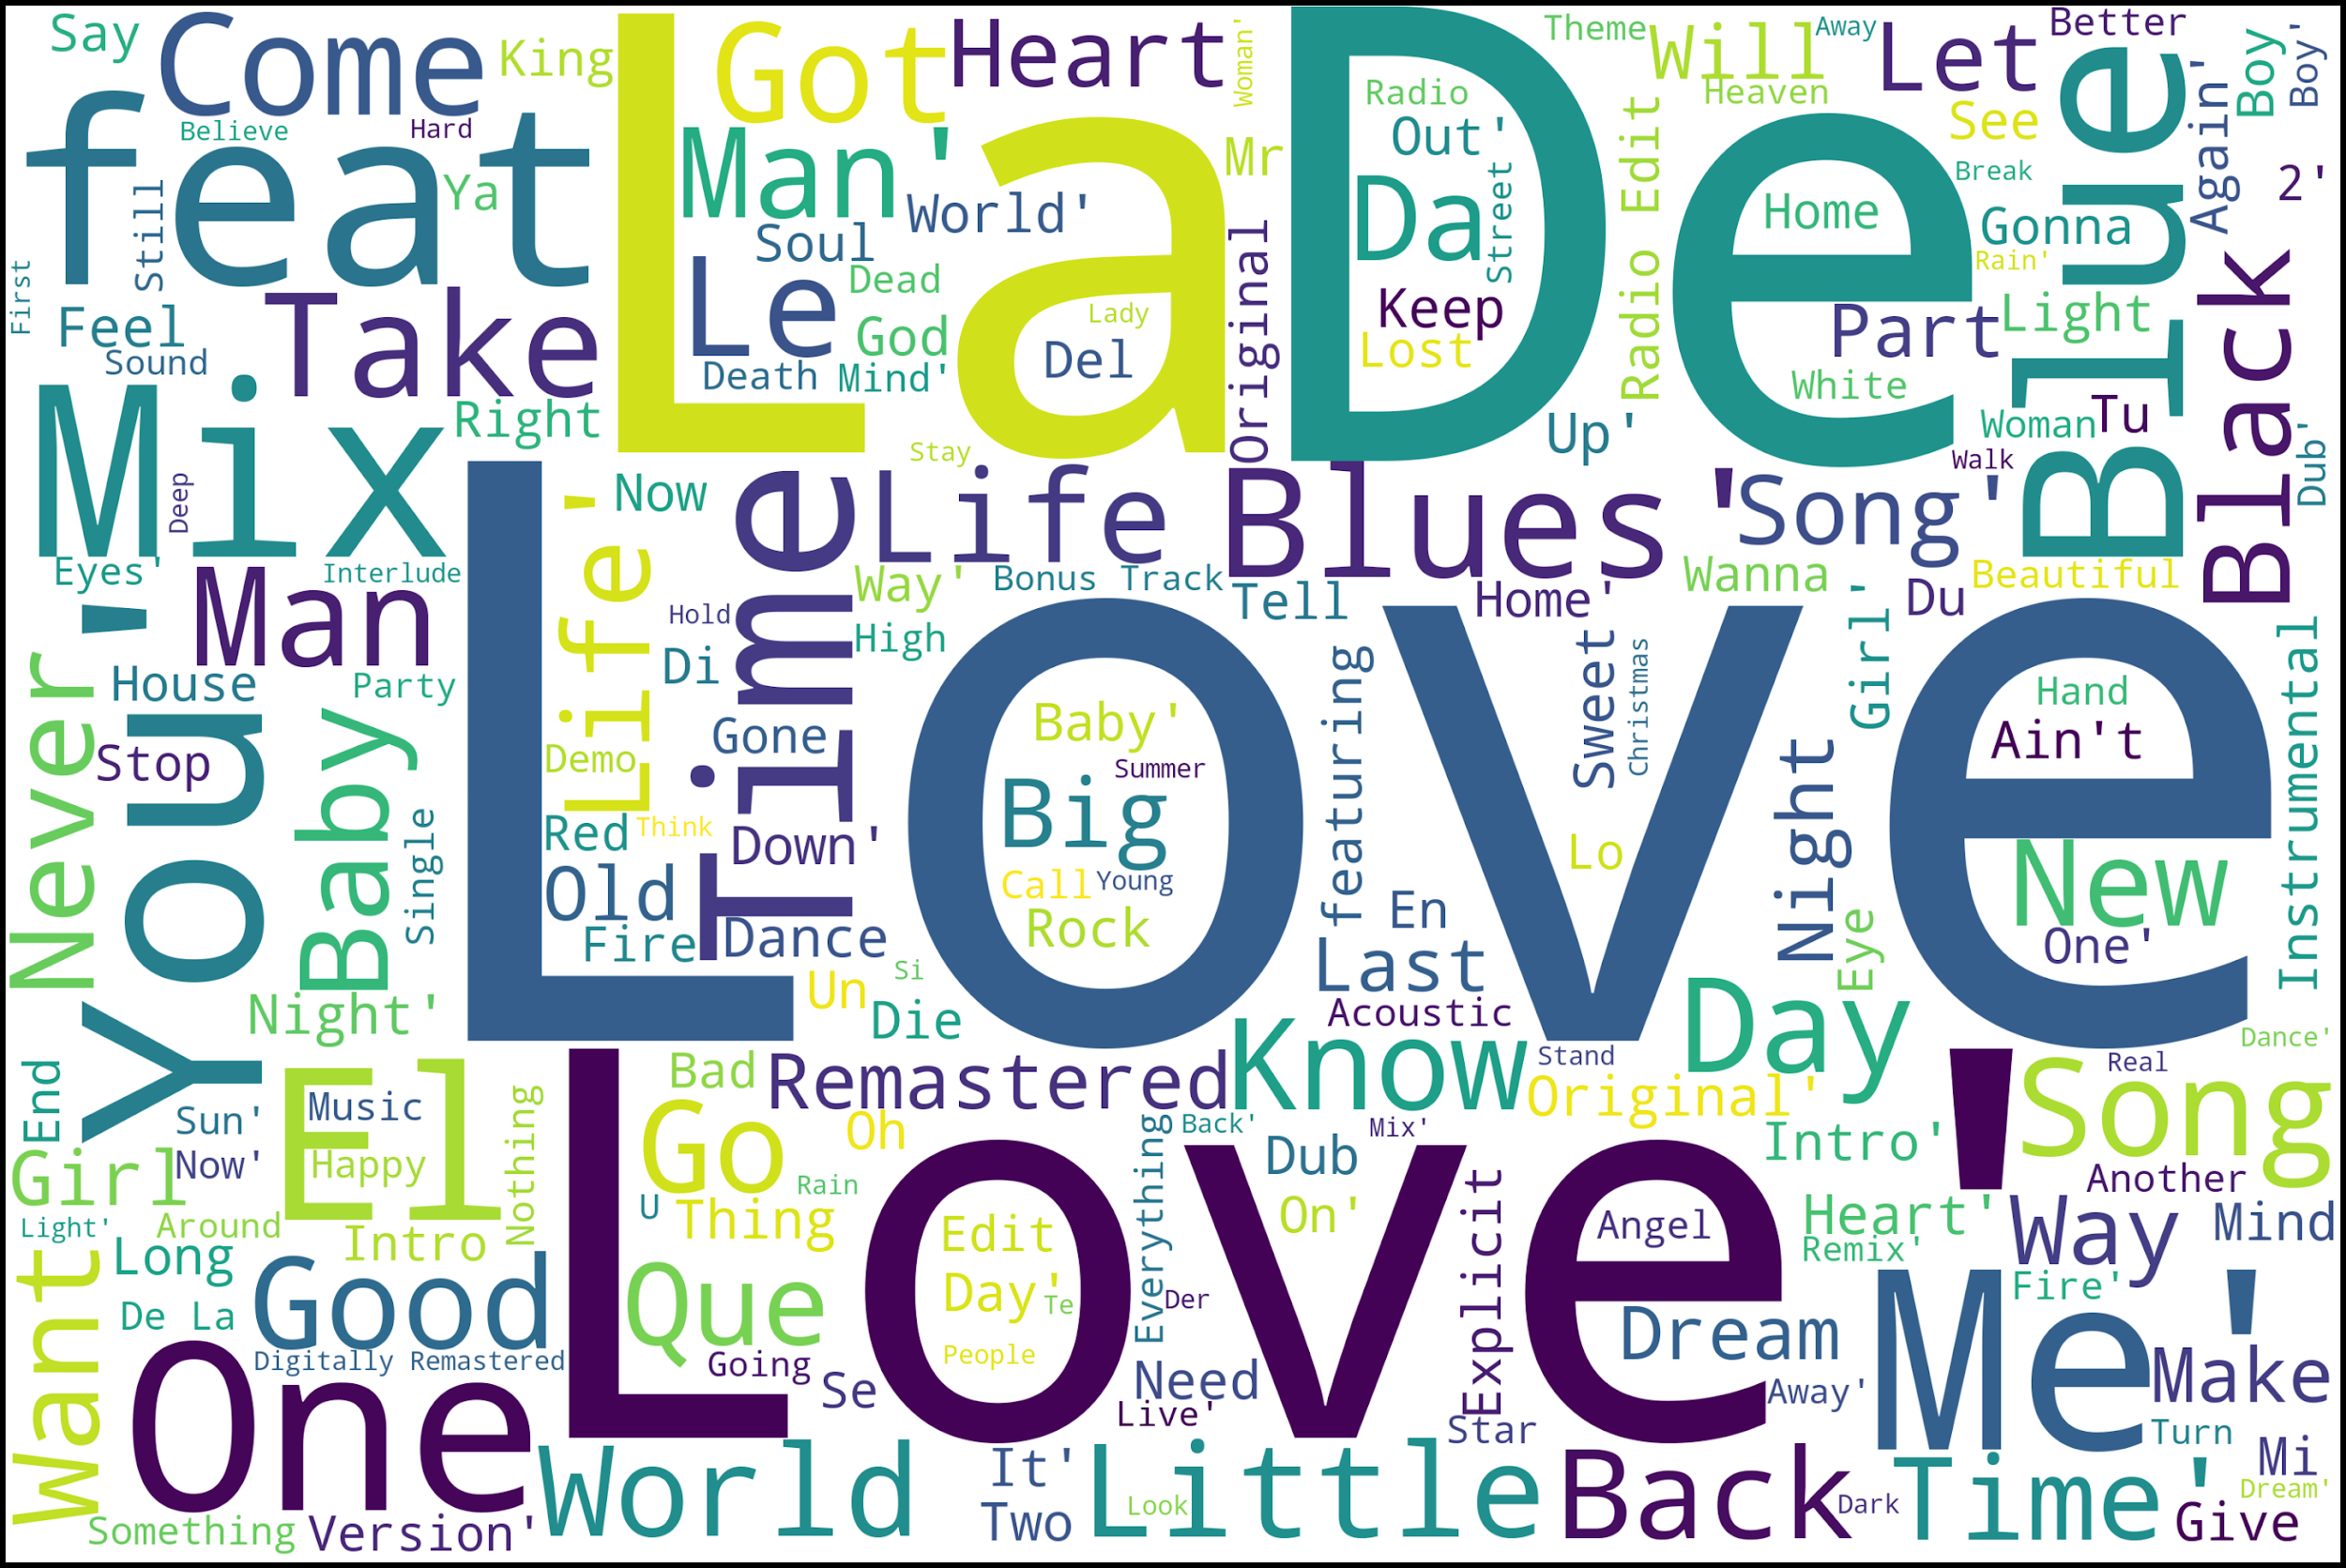
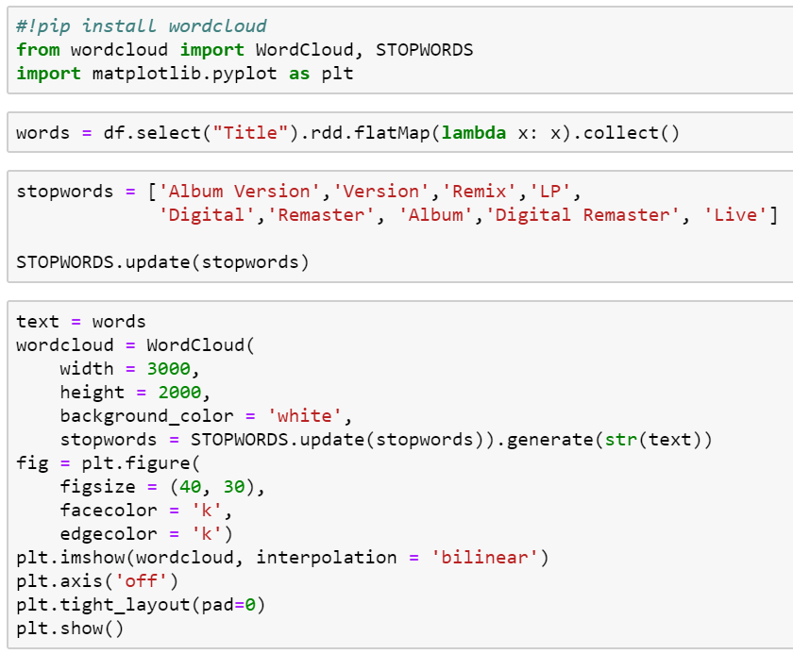
What Should You Name Your Song?
La De Love

Slide 10
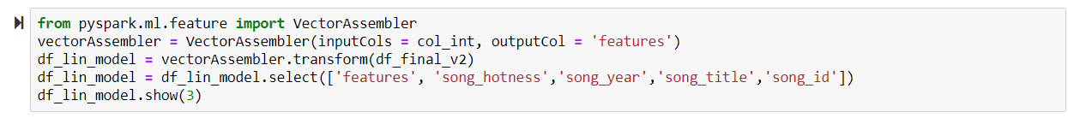
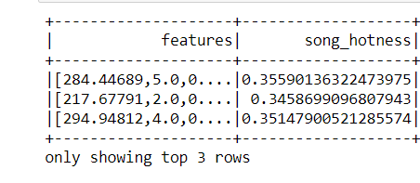
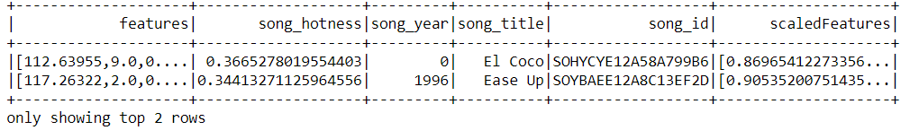
Pipeline:
EDA to understand the data and identify the important features
Input all the features to the vector assembler
Create a vector from the features
Use the feature vector for scaling
Input scaled features to the ML model
Building a pipeline for ML

Slide 11
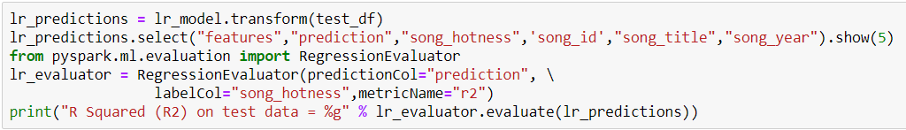
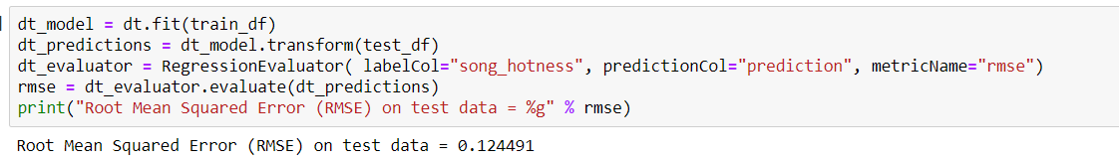
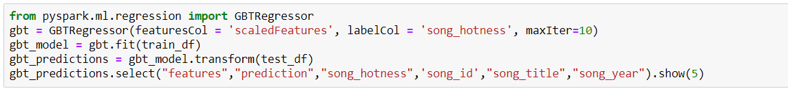
Prediction Techniques:
Linear Regression
Decision Tree
Gradient Boosting
With 3-fold cross validation
Method | RMSE (test data)
Linear Regression | 0.125
Linear regression- CV | 0.122
Decision Tree | 0.124
Decision Tree-CV | 0.121
Gradient Boosting | 0.125

Slide 12
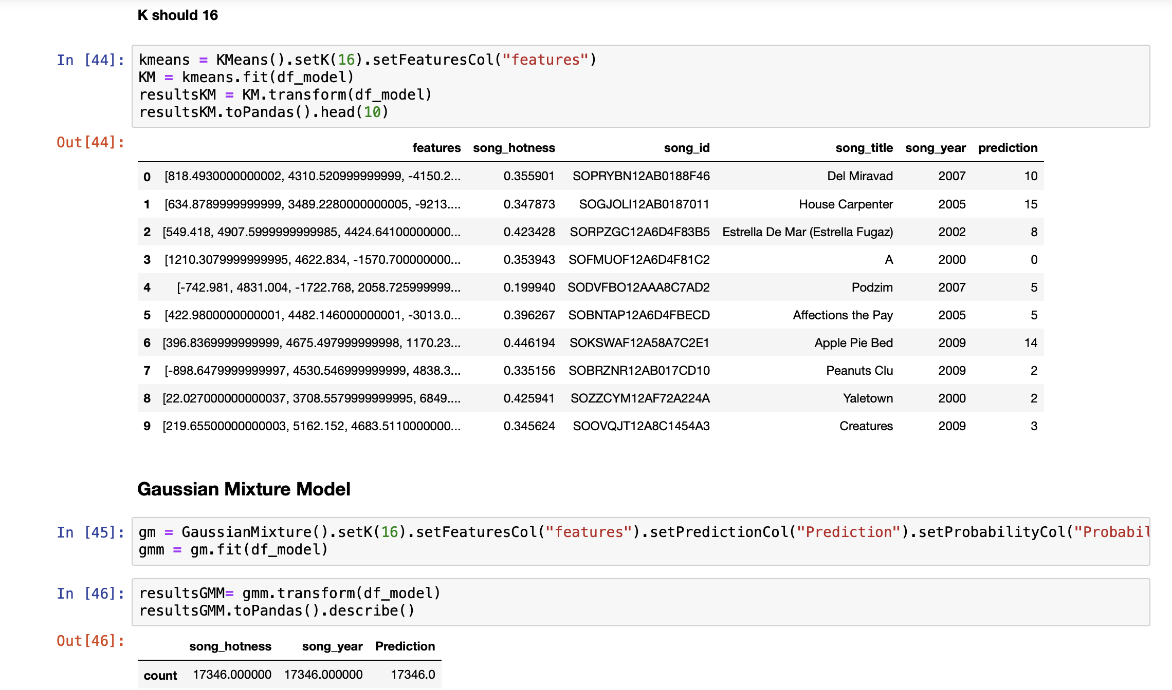
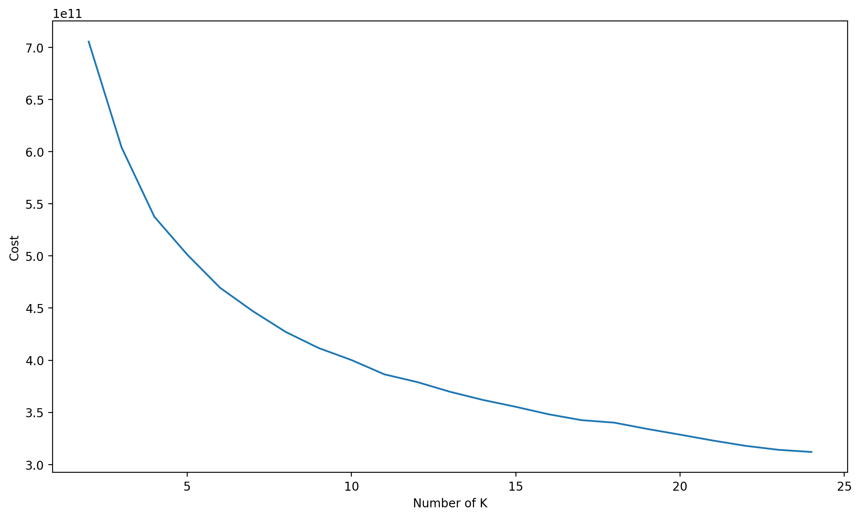
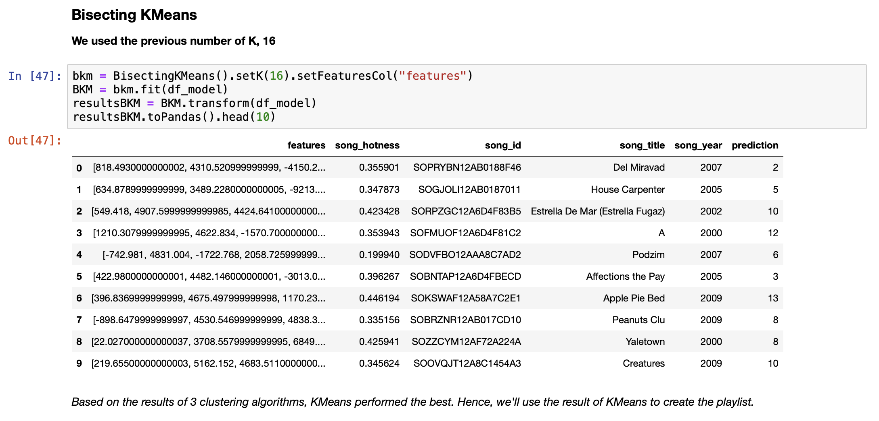
Clustering on Spark:
K-Means
Gaussian Mixture Models (GMM)
Bisecting K-Means

Slide 13
DEMO

Slide 14
Next Steps
Combine Last.fm data with Million Song Dataset to gain access to tags and similar songs
Plot spectrograms of the MFCCs and classify songs using CNN
Improve GUI

